Slide 1


A Mobile Journey – Cross-device integration with Azure and Office 365
Thivyakanth Ruthramoorthy
Rory Braybrook
OFC223

Slide 2
Find us on Twitter
@thivy
@rbrayb

Slide 3
You can leverage the functionality of Office 365 on mobile devices by using the API, Xamarin and Azure Identity

Slide 4
Overview
Office365 / AAD
Office365 API / Tool
ADAL
Xamarin
Notes:
RB

Slide 5
Office 365 and Azure Active Directory
Notes:
AAD has always been behind O365.
In the beginning, was hidden but then opened up to allow access to applications, assign groups, SaaS, mobile services etc.

Slide 6

O365 provisioning is limited
Users
Groups
Global Administrators
Custom domains
Notes:
RB - Office 365 → tenant name (something.onmicrosoft.com) → AAD tenant
Office365 creates WAAD accounts but only allows you to configure users, groups, custom domains and global administrators from Office365
AAD lets you manage the advanced features e.g. AAD Premium, application access and rights, SaaS SSO and MFA

Slide 7
AAD provides advanced provisioning
AAD Premium
Access and rights
Single
sign-on
MFA
Notes:
RB

Slide 8
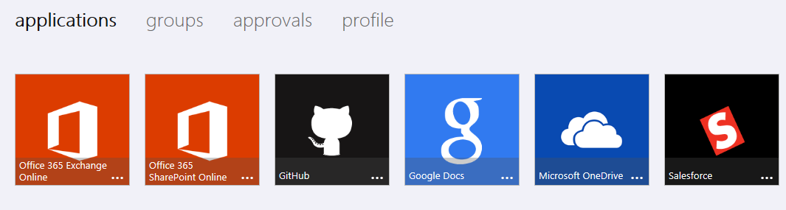
AAD implements O365 as SaaS
myapps.onmicrosoft.com
Notes:
RB

Slide 9
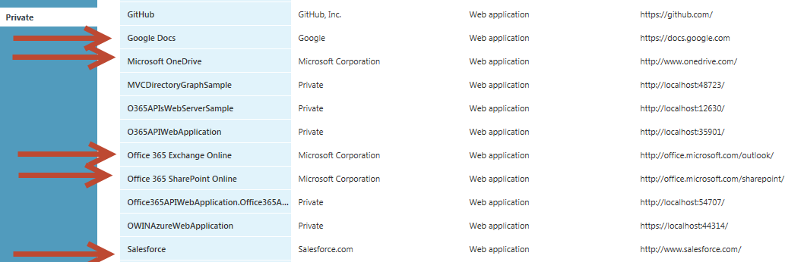
O365 is an application in AAD
Notes:
RB

Slide 10
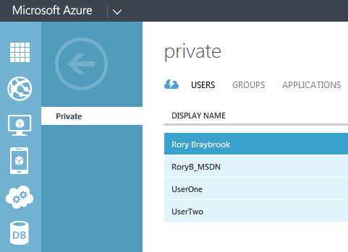
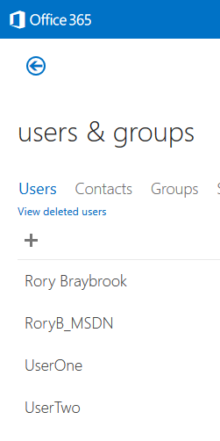
O365 / AAD have common user set
Notes:
RB – Two portals with different functionality on top of the same set of data filtered by tenant.
O365 has additional functionality to add licences.
Just because you are a user in AAD does not mean that you can use O365.

Slide 11
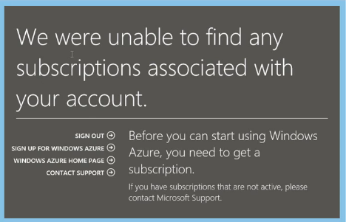
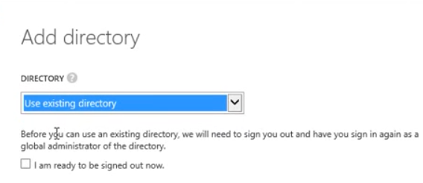
Portals can be merged
Moving your Office 365 directory & users in to the Azure AD Portal - plankytronnix
Notes:
RB – Two ways of integrating:
O365 – add Azure – no subscription – use O365 credentials – credit card - no charge
Azure - add new AAD instance – use existing account
Google “office 365 azure youtube” – 4 minute video from plankytronnix

Slide 12
Office 365 API (In Preview)
Notes:
RB – In preview.
3rd preview – 5th August.
Not complete – bugs – incomplete documentation – new releases break stuff.
Third release broke second release because they changed direction based upon feedback.
Means of asking for feedback.
Sits on top of ADAL.

Slide 13
O365 API
AAD
SharePoint
Exchange
Lync
Notes:
RB - A consolidated Office 365 API set that spans SharePoint, Exchange, Lync and Azure Active Directory
Exposes Calendar, People / Contacts, Mail and File Office 365 APIs
Discovery Service APIs that allow you to determine the location of related Office 365 services for particular users, including Files, Calendar, and Mail APIs
These APIs use REST / OData for data transport and OAuth2 for authentication and authorization
You can program directly against the REST APIs to interact with Office 365 but it requires you to write and maintain code around managing authentication tokens, constructing the right URL’s and queries for the API you wanted to access and perform other tasks

Slide 14
O365 API
Calendar
People / Contacts
Mail
Files
Notes:
RB

Slide 15
Office 365 APIs Roadmap
Active Directory
Exchange & Outlook.com
SharePoint
OneDrive
Sites
OneDrive
Users
Mail
Calendar
Client API
OneDrive for Business
Sites, Lists and Libs
Taxonomy
Groups
Contacts
Workflow
BCS
Search
…
Notes:
TR

Slide 16
Find services with Discovery Service
Discovery Service API allows you to determines location of related O365 services for users
Files
Calendars
Mail
Notes:
RB - Automatically determine URL of O365 services
Supports device app and website flows
Secured using Azure AD authentication
Serves information stored about services in AAD

Slide 17
O365 API built on standards
REST / OData data transport
OAuth 2 authn / authz
Notes:
RB – Web applications
Native applications – Windows 8, iOS, Android

Slide 18
Common Consent Framework
App
Consent
AuthCode
AuthCode, AppId, AppSecret
Access and MRR token
Access token, AppSecret
Access and information
AAD
Office
365
Notes:
RB – Allows you to swop resources without having to re-authenticate.
Cleaner user experience.

Slide 19
Common Consent Framework - MRRT
App
MRRT
Access and MRR token
Access token, AppSecret to new resource
Access and information
AAD
Office
365
Notes:
RB – swop resources.
Also for token timeout.

Slide 20
You can “Roll Your Own”
Manage authentication & refresh tokens
Asynchronous support
Construct the right URL’s and queries
Manage the cache
Configure AAD
Notes:
RB

Slide 21
SharePoint Scopes
Edit or delete users’ files
Read users’ files
Have full control of site collections
CRUD for items and lists in site collections
Notes:
RB – In OAuth terms, these are the scopes
4 / 5 / 4

Slide 22
Exchange Scopes
Have read / full access to users’ contacts
Have read / full access to users’ calendars
Send mail as a user
Read and Write access to users’ mail
Have full access (user_impersonation) to mailbox
Notes:
RB

Slide 23
Microsoft Azure Active Directory Scopes
Access our organisation’s directory
Read directory data
Write directory data
Enable sign-on and read user’s profiles
Notes:
RB

Slide 24
Office 365 Tool

Slide 25

Development Platform
Contextual Apps
Notes:
This is what office currently have now.. as a developer you can build inside the current desktop applications like word or excel and extend the experience or server products like sharepoint or project

Slide 26



Development Platform
Contextual Apps
Robust APIs
Documents
Search
Mail
Social
Calendar
People
Notes:
With the new set of APIs that got introduced you don’t have to build inside office products anymore. You can actually bring all the rich features that lived within office products and bring them out to all the other platforms out there now. This is really exciting because more and more people are starting to bring their consumer application into the enterprise world. James showed a really good example of flight booking at the keynote. It is actually possible with the new APIs where you can grant permission to apps that requires your calendar details or your contacts.

Slide 27




Development Platform
Contextual Apps
Robust APIs
Flexible Tools
Documents
Search
Mail
Social
Calendar
People
Notes:
You are not just tied to one single platform. You can go beyond mobile. You can host your solution in AWS you are not just tied to Azure.
One interesting logo in that 3rd box is the HTML 5. There is currently a Javascript librabry that can download and integrate with angular js or

Slide 28
Demo
VS 2013 Office API Tool

Slide 29
The Future
Adding new endpoints
More APIs (Tasks, Office Graph)
iOS SDK
Notes:
TR

Slide 30
Active Directory Authentication Library (ADAL)
Notes:
RB –
V2 GA’d on Sunday
ADAL for .NET V2 = only .NET 4.5
No support for ACS – use V1
Becoming Microsoft API standard:
Graph API / Office 365 API / Azure Management API / InTune API
Now open source

Slide 31
Active Directory Authentication Library (ADAL)
Notes:
RB -
Authenticating Users of a Client Application to a Remote Resource e.g. O365:
Authenticating a Server Application to a Remote Resource:
Authenticating a Server Application on Behalf of a User to Access a Remote Resource:
user_impersonation

Slide 32
Active Directory Authentication Library (ADAL)
Notes:
RB – Used to be AAL but now extended to on premise with Server 2012 R2 – ADFS
Be aware ADFS only caters for authorization code grant – AAD handles all 4.

Slide 33
ADAL Mission statement
The Active Directory Authentication Library (ADAL) is a library meant to help developers to take advantage of Active Directory for enabling client applications to access protected resources

Slide 34
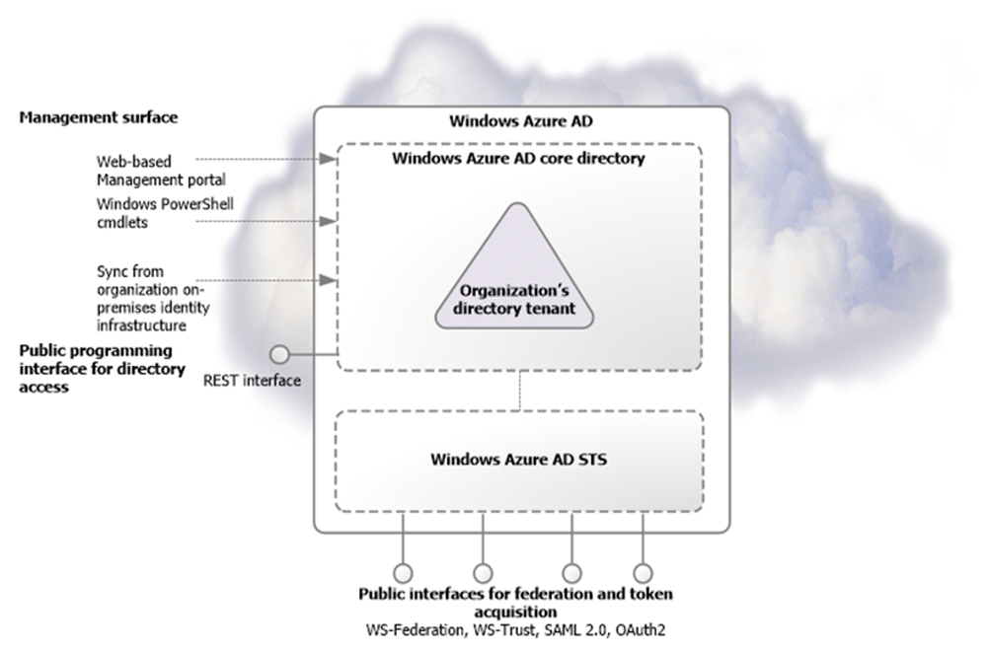
From: Microsoft – Active Directory from on-premises to the cloud
Notes:
RB

Slide 35
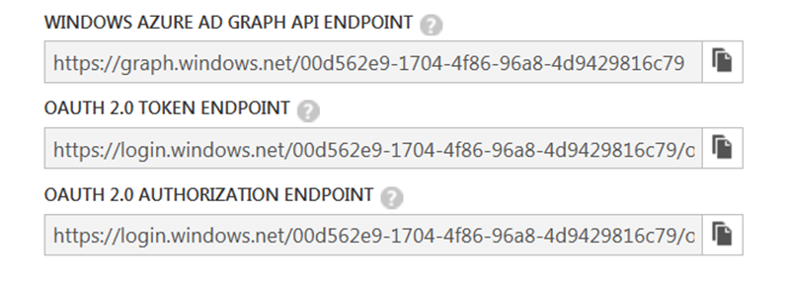
AAD OAuth endpoints

Slide 36




Manipulate AAD using API
Use OAuth endpoint to get token
AAD
Use token in REST call to endpoint
Token issued
Notes:
RB

Slide 37
Authentication and Authorisation to API
Azure Active Directory
Azure AD
1. Request JWT token
(pass input claims)
Azure AD Authentication Endpoint (OAuth)
Application
2. Return
token
REST Service
Validates token, processes request, returns data
Authorisation Check
3. HTTP Request
with JWT Token
4. Return
Response and
Data
Notes:
RB

Slide 38
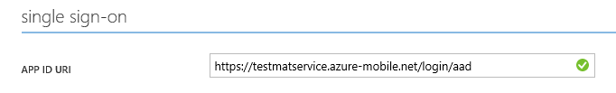
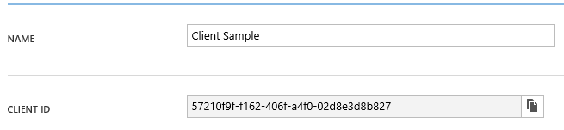

Active Directory Authentication Library
string clientId = "[Enter client ID as obtained from Azure Portal]";
string authority = "https://login.windows.net/[your tenant name]";
string myURI = "[Enter App ID URI of your service]";
AuthenticationContext authContext = new AuthenticationContext(authority);
AuthenticationResult result = await authContext.AcquireTokenAsync(myURI, clientId);
Notes:
RB

Slide 39
The common endpoint
https://login.windows.net/your-tenant.onmicrosoft.com/oauth2/authorize
What about multi-tenant?
https://login.windows.net/common
Notes:
RB – How do you write the code?
Multi-tenant
Uses late binding based on tenant name.

Slide 40
ADAL multiple resource refresh token
// Create a client credential based on the application ID and
// secret.
ClientCredential clcred = new ClientCredential(AppPrincipalId, AppKey);
// Use the authorisation code to acquire an access token.
var arAD = ac.AcquireTokenByAuthorizationCode(code, new Uri(appRedirect), clcred);
…...
// You need a new access token for new workload. Check to determine
// whether you have the MRRT.
if (arAD.IsMultipleResourceRefreshToken)
{
// This is an MRRT so use it to request an access token for
// SharePoint.
AuthenticationResult arSP = ac.AcquireTokenByRefreshToken(arAD.RefreshToken,
AppPrincipalId, clcred, "https://xxx.spo.com/");
}
Notes:
RB

Slide 41
Show me some code!
Office 365 Users and Groups

Slide 42
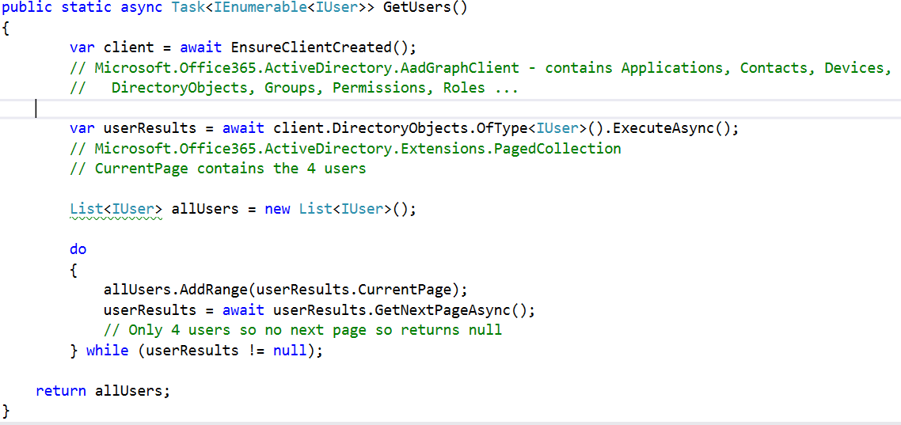
Users and Groups API - GetUsers
Notes:
RB

Slide 43
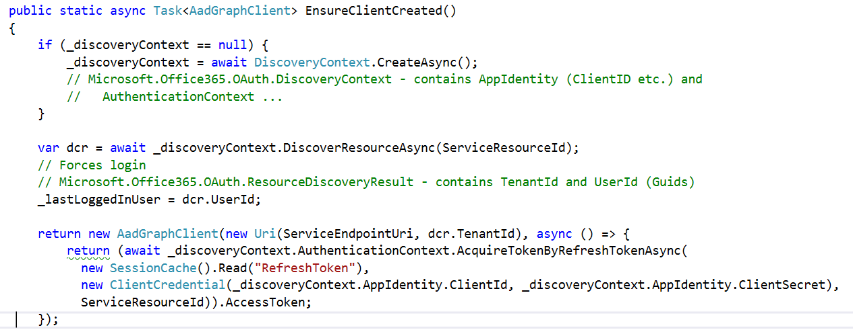
Users and Groups API - Client
Notes:
RB

Slide 44
Users and Groups API - GetUsers
Notes:
RB

Slide 45
Mobile app
Strategies and Architecture
Notes:
- We talked about all the available APIs and SDKs in the previous
- Let’s have a look at what strategies and architecture we have to leverage these APIs build mobile application.

Slide 46
Native Tools
Xcode
Objective C
Notes:
We have the traditional approach of using the native tools to build mobile application
One day your company decided to build an awesome iPhone app, what do you do first? You hire people with Xcode/objective C knowledge

Slide 47
Native Tools
Xcode
Objective C
Everything is awesome
Notes:
You submit that to the apple store and everything awesome!!
Then few months later android takes over the world by a storm, suddenly you have 80% of the mobile are powered by android.
So what does your manger do? He comes and ask the iOS developers.. Guys lets release our app for android.
And what does the iOS developers say?? Oh no no.. We don’t want to touch Java its google and the developers get all emotional.

Slide 48
Native Tools
Xcode
Objective C
Eclipse
Java
Notes:
So now your manager goes and hires whole bunch of new Java developers to build this same app on Android.

Slide 49
Native Tools
Xcode
Objective C
Eclipse
Java
Visual Studio
C#
Multiple code bases harder to maintain
Three different teams with three different set of skills
Most expensive approach
Notes:
And now Microsoft comes along and introduces Windows 8 and Windows phone and your manger goes and hires whole bunch of C# developers.
As you can see your company have three awesome apps in the market but your manger will realize that it is costing him three times more than what it used to cost for iPhone app because you have three different apps to maintain which does the same thing.
So what does your manger do?? He comes and ask the developer is there a way to write the code one and run it on all three devices??
What does the developers say? Of course there is a way… its called hybrid applications

Slide 50

Hybrid Applications
Write Once Run Anywhere
HTML 5 | JavaScript | CSS 3
Black Box
Cross complier
Yes We Can
Notes:
Now this is one of the most commonly used approach in the market.
That phrase catches you immediately “Write once and Run Anywhere”… This is great because now you have your apps running on billions of devices with single code base.
How does this work? You write code with HTML/javascript just like you would do in web and put it into this magical black box in the middle and depending on which button you click it will pop out an iPhone app or and android app or a windows phone app.

Slide 51
Hybrid Applications
Write Once Run Anywhere
HTML 5 | JavaScript | CSS 3
Black Box
Cross complier
Yes We Can
Notes:
The problem with this though you are coding against a set of APIs that are common denominator across all three platforms such as GPS, accelerometer, camera and so on... Because these APIs are common denominator across all these platforms you are not going to be able to leverage APIs that are specific to the platform. For example the built in animations for iOS or the widgets feature on android
And if you look at an app that is built using hybrid approach you can easily tell that it was built with HTML/Javascript because they don’t perform as well the native application and it wont even reflect the platforms native UI look and feel…
Is this a good approach?

Slide 52
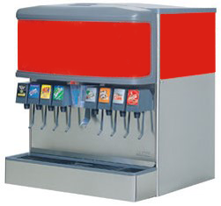
Hybrid app
Native app
Notes:
The reason I say that is because of this…
Think of the hybrid application as a soda fountain and a native application as a coke bottle from the fridge.
When you go up to this soda fountain there is this magical black box at the top and you have different buttons for all the different drinks you can get.
You press the Fanta button.. You get Fanta… You press the coke button you get coke.. But have you tried to compare the taste of coke from the fountain and the coke from the bottle? They taste completely different.. Bottle of coke will taste much more richer than the coke from the soda fountain.
I don’t want to pay for a drink that is going to taste like a water.. I’ll pay for a drink that is going to be rich in taste…
This is the exact same for mobile applications…

Slide 53
Users expect rich experience for mobile applications
Notes:
Users expect rich experience for mobile applications.. It doesn't matter if your application is free or 99 cents..
Once they download your app.. They own you.. And if your app crashes or performs really bad.. You start getting threatening emails like I am going to kill you or give me my money back..
Take facebook for example.. When they first launched their it used to be native but then changed strategy and said HTML 5 is the future for mobile applications and they released a new app built with HTML 5 and JavaScaript. What happened to their rating?

Slide 54
Facebook (HTML)
1500 reviews
Average rating of 2.0
Notes:
Their rating went down all the way to 2…
Most of the bad reviews were based on how slow the app performs..
Then mark Zuckerberg came and said we are going native… and look what happened to their rating..

Slide 55
Facebook (Native)
2500 reviews
Average rating of 3.9
Notes:
Almost 4…
This is a really good rating considering the number of users use facebook app compared to all other apps in the market place…
And facebook is just one example of an app who switched over to native application.. There are many other case studies you will find why native approach is better over hybrid…
So if native is the best way to go forward
Then How do we minimize the cost and effort to build cross platform applications?
How do we share as much code as we can so we have less bugs across all three platforms..
Well Xamrin has answer to these question..

Slide 56
Xamarin
Native UI on every platform
Share code with portable class libraries
100% API coverage for all platforms
Use Visual Studio or Xamarin Studio as development IDE
HTML 5 | JavaScript | CSS 3
C# shared code
IOS
C# UI
Android
C# UI
Windows
C# UI
Notes:
Xamarn takes a different approach to all other cross platform tools
The way you architecture you application with Xamarin is you put all the code that you can share in one single project and share it across other platform specific projects. You can share code like accessing web services… or your business logic … or storing data locally on your device. And then you write your iOS UI with C# and the android UI with C# and so on..
And the best thing about Xamarin is you have 100% API coverage to all platforms supported by them.. And what's even better you can use Visual studio with resharper to build you iphone or android applications.

Slide 57
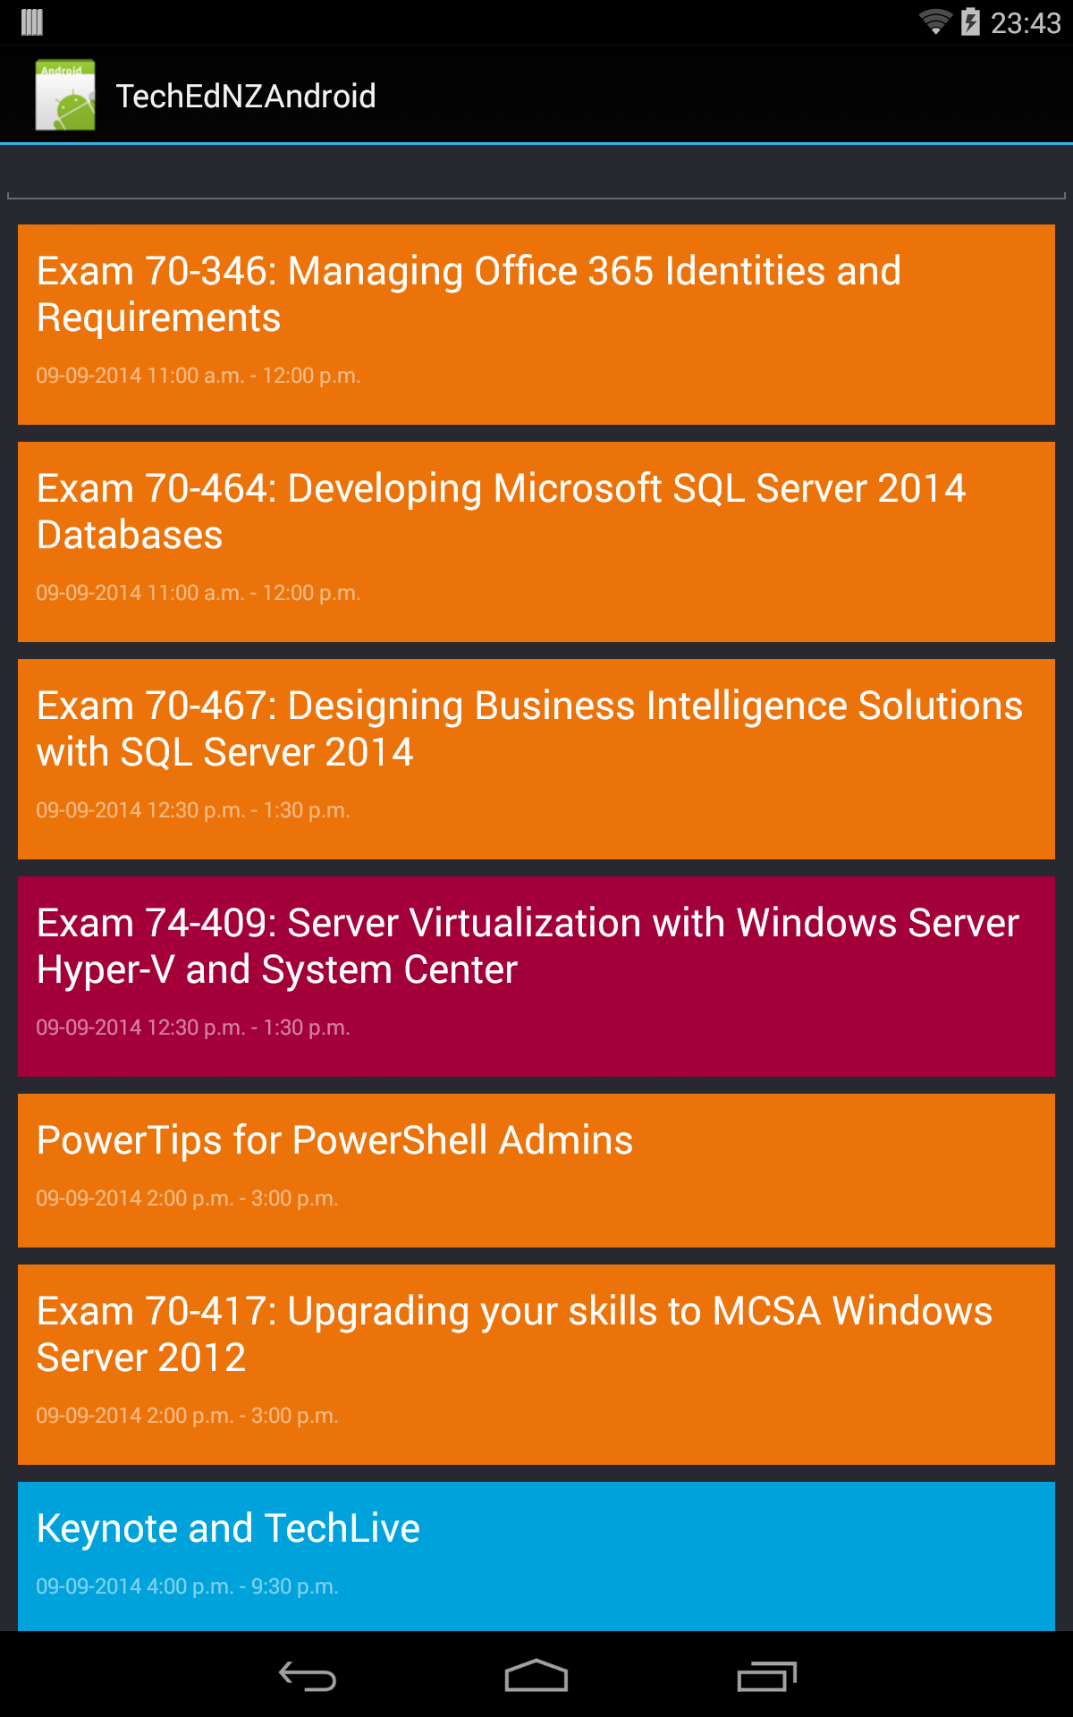
TechEd Session App
Notes:
TR

Slide 58
Demo
End-to-end Demo

Slide 59
You can leverage the functionality of Office 365 on mobile devices by using the API, Xamarin and Azure Identity

Slide 60

Related content
WIN313 Building cross-platform mobile apps using Microsoft technologies and Xamarin
PCIT208 Azure Active Directory - Identity Management in the Cloud
Find Us Afterwards At... Closing drinks

Slide 61
Resources
Office 365 Dev Centre APIs Preview – http://dev.office.com
Office 365 Tools Preview - http://aka.ms/office365apitoolspreview
MVA - Introduction to Office 365 Development training - http://blogs.office.com/2014/08/25/introduction-office-365-development-training-available-demand-microsoft-virtual-academy-free/
Getting started with Xamarin - http://developer.xamarin.com/guides/cross-platform/getting_started/
Xamarin university - http://xamarin.com/university

Slide 62


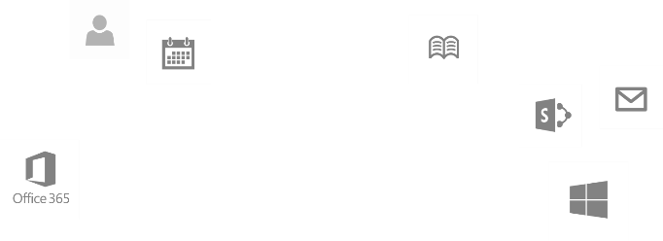
Calls to action
Explore our MSDN library
http://dev.office.com
Play with our code samples
http://aka.ms/OfficeDevSamples
Follow our patterns & practices
http://aka.ms/OfficeDevPnP
Get answers
http://aka.ms/AskSharePoint
http://aka.ms/AskOffice
Give feedback Drive our roadmap http://aka.ms/OfficeDevFeedback

Slide 63






Resources
Microsoft Virtual Academy
TechNet Virtual Labs
Free Online Learning
Free Virtual Hands-on Labs
http://aka.ms/mva
http://aka.ms/technetlabs
TechNet & MSDN Flash
Subscribe to our fortnightly newsletter
Sessions on Demand
http://aka.ms/technetnz http://aka.ms/msdnnz
http://aka.ms/ch9nz

Slide 64
Complete your session evaluation now and win!

Slide 65

© 2014 Microsoft Corporation. All rights reserved.
Microsoft, Windows and other product names are or may be registered trademarks and/or trademarks in the U.S. and/or other countries.
MICROSOFT MAKES NO WARRANTIES, EXPRESS, IMPLIED OR STATUTORY, AS TO THE INFORMATION IN THIS PRESENTATION.

